Slide 1
Final Year
Research Project
2020
By Aaron O’Dea

Slide 2
Main topic intro
The use of a Genetic algorithm to create a growing NPC population with an overarching Goal

Slide 3
Why I chose this topic
I choose this topic because I want to explore the Idea of using a genetic algorithm to create a more realistic feeling with a overarching end goal for the NPC population.
I wanted to explore this area because through my research I could not find many games which used a technique like this.Mostly games with NPC population used pre scripted sequence or a basic algorithm which increase the population based on other factors.

Slide 4
What this project will consist of
This research Project will consist of a look into what causes a NPC population to fail.
What types of methods within a genetic algorithm can be used to create more varied NPC population (Different crossover , Mutation and reproduction methods)
How these methods compare to a prescripted NPC population.
How could this Research be implemented into Projects in the future

Slide 5
Research done
So far i have researched different types of genetic algorithms used in games today and what they are usually used for within these games
Such examples of these games are Massive chalice by Double Fine this game is a strategy game which uses a genetic algorithm which allows the player to pair heros to create a new child hero of mixed Genetics
Another Example is Darwin's Dinner by Double Fine which uses a Genetic algorithm to create a new population of creatures each year cycle based on remain creatures in the world

Slide 6
Some other Research which i have done is Different Methods of Crossover of DNA within Genetic algorithms
Single point , Two-point crossover,
Uniform crossover,
Whole arithmetic recombination,
Davis’ order crossover

Slide 7
Progress so far (first Review)
The progres that I have completed so far is setting up an initial project structure .
In this initial project I have created an npc class which when initialized spawns an NPC character in the world.
These Npc characters are created when two npcs which are of opposite gender and are currently available to reproduce (reproduction timer = 0).
When theses conditions are meet the new NPC inherits the parents DNA using a simplistic 1 point crossover this means that the first half of the 1st parents DNA string and the second half of the second parents DNA string are combined and given to the new child NPC.

Slide 8
This new DNA string then is then mutated the mutation method that I am using for the Demo is one which adds or subtracts a number based on predetermined variable.
Other Progress includes displaying of statistics of the NPCs. Generation, age Health.
As Well as age restriction for reproduction as well as an age limit for the NPCs
Some basic effects from the DNA to the actual NPCS e.g. size, Speed

Slide 9
Progress so far (Second Review)
Added in a second algorithm
Added in a second mutation
Added data output and statistics around the screen
Added more data to the slime character (DNA string)
Fixed Dna transfer.
Added Colour for genome strings and sidebar statistics
Added Main Menu with basic Input from the User
Added circle which tracks the highest NPC of the current track Statistic.

Slide 10
Progress so far (Final Review)
Added in Main menu which allows the user to Determine multiple aspects of the System
Some of these setting are Age cap which mutation which algorithm. Reproduction chance starter amount
Which statistics you want the population to aim for different mutation rates.
Added in more DNA influences which affect the npcs for instance strength determines the ability to stay alive longer and intelligence affects the ability to take less damage from events
Added more events which affect the health of the players these events affect the the NPC’s with a higher DNA statistic of the same event type.
Added better collection of data and made the graphs better show the increase of the tracked statistic.
Created an output for Data as well this data is outputted to a text file at the end of the run.Also added a reset to do multiple runs with one set of settings.

Slide 11
Added a percentage of NPCs affected by the events and made an indicator which highlights them.
Created a statistics File which show all of the gather data of different variation of Statistics and how they compare to each other. https://drive.google.com/open?id=1r7-gLxFz2D7vO-gM68zBUP6AkJWcbF9JqI8KnobQVUE

Slide 12
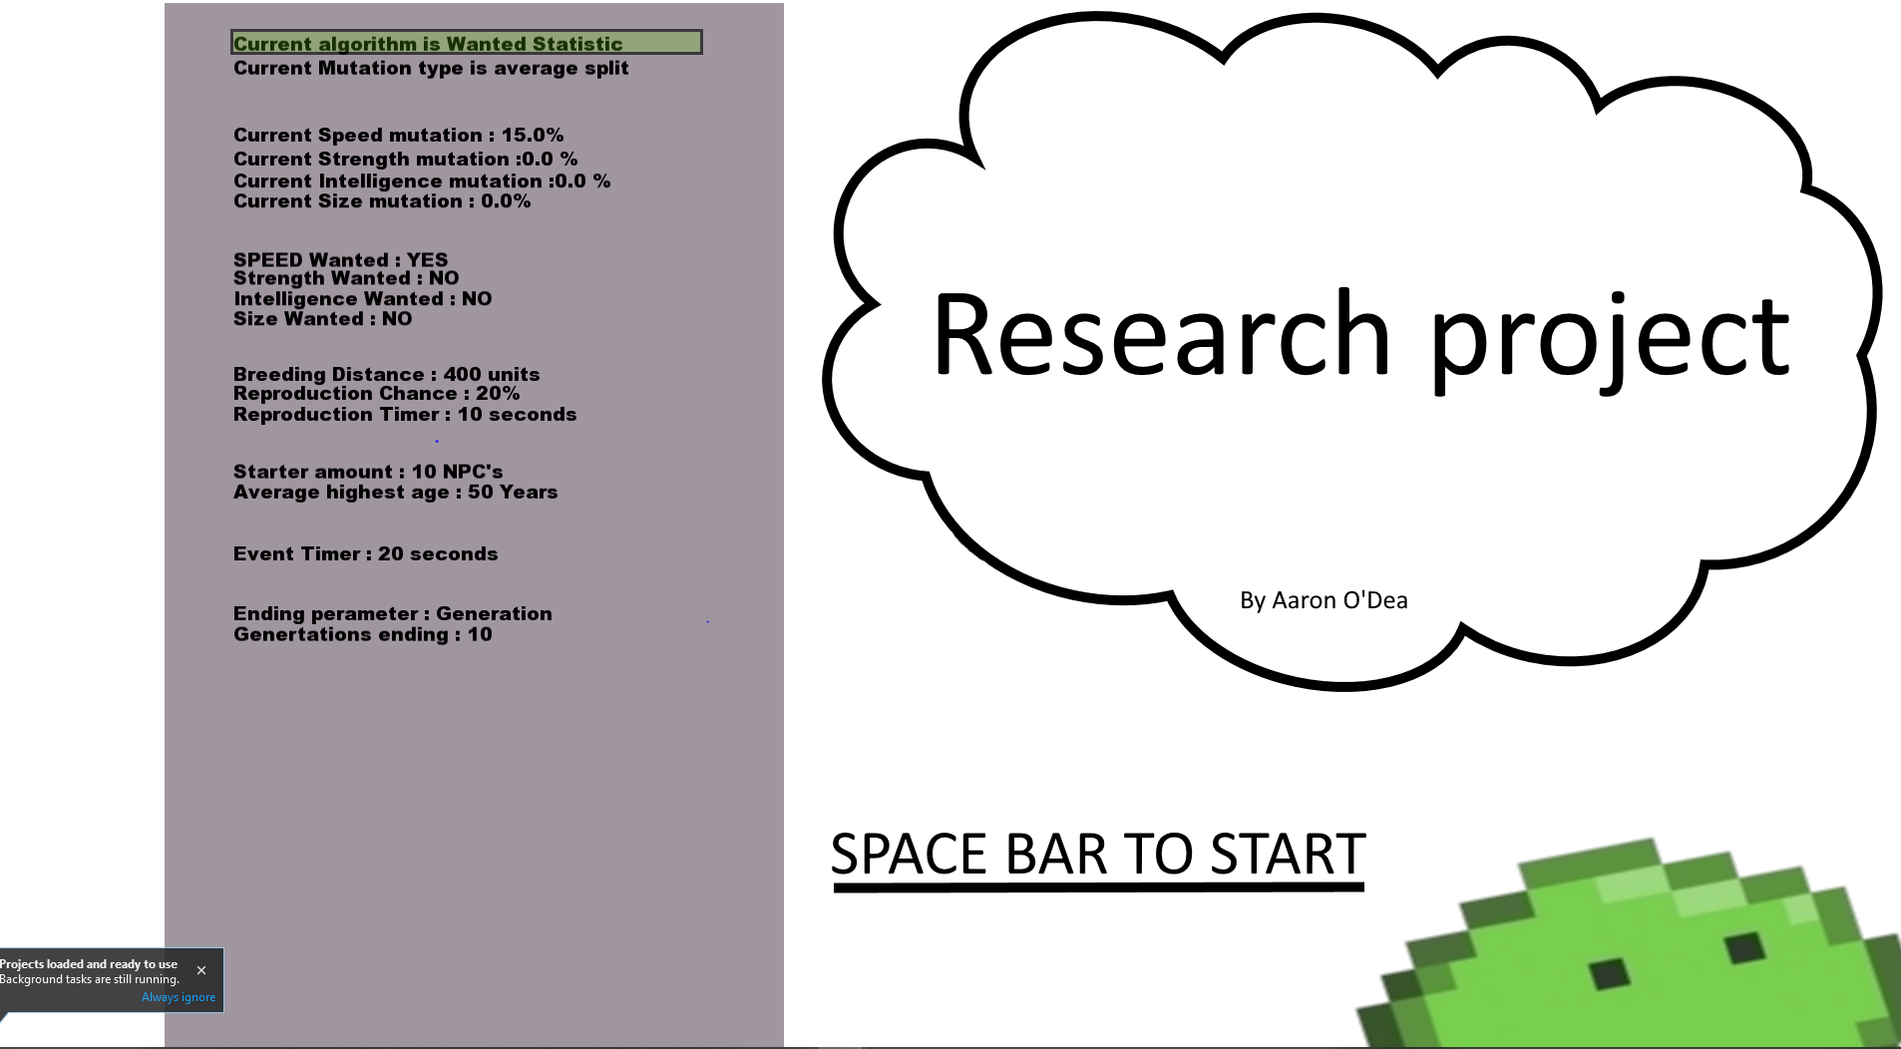
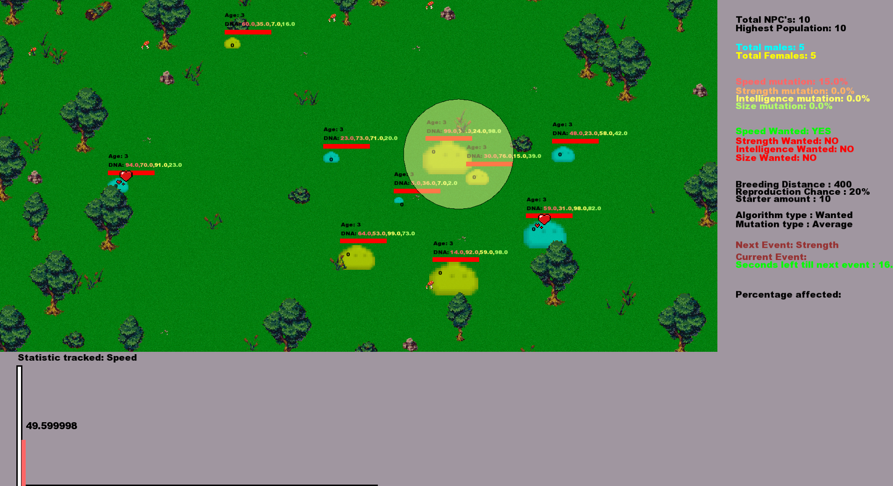
Example Pictures
Main menu
Main Play screen

Slide 13
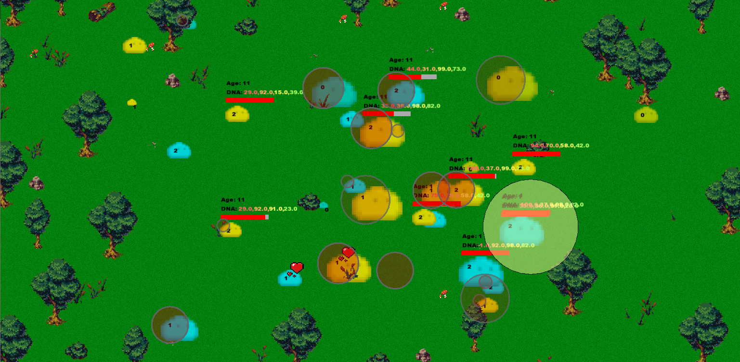
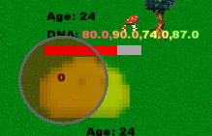
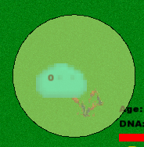
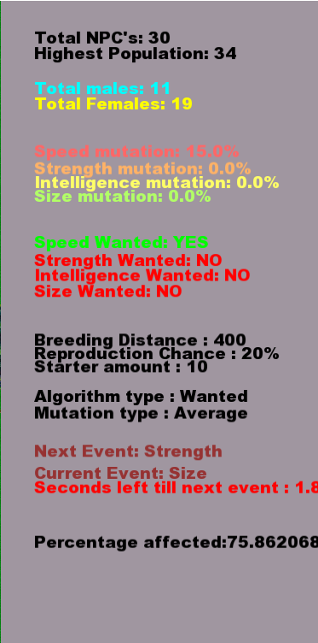
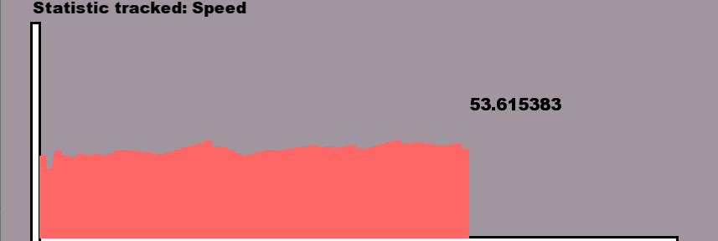
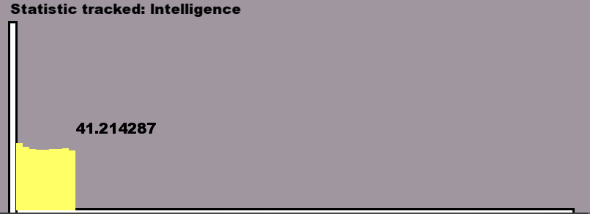
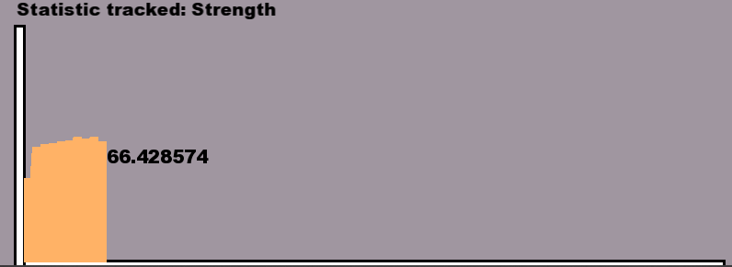
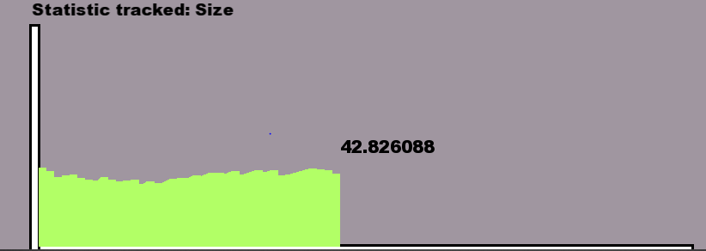
Main Npc plain
If affected by an event tracker
Highest Statistic tracker
Side panel Statistics
Different Statistics Graphs

Slide 14
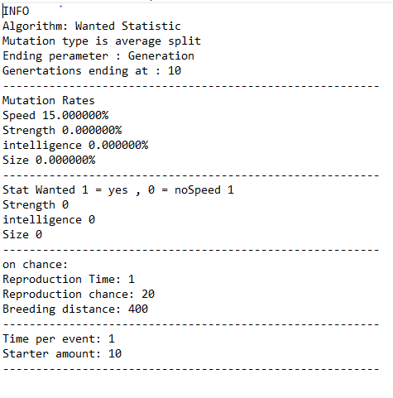
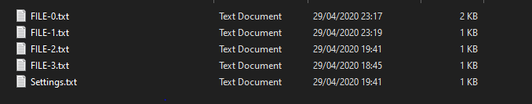
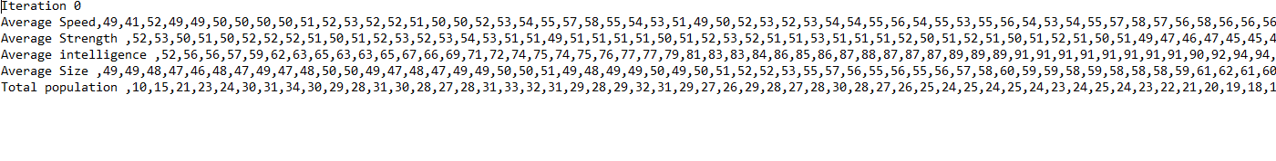
Settings file data
Output files
Output file data

Slide 15
Noted Problems
Some of the problems that have come to may occur during the system running
A huge increase in population (population explodes causes data skew)
NPC’s to far from each other causes npc to die off before reproduction
High amounts of NPCs cause a reset to not fully work due to speed restraints
High amounts of NPCs cause a lag due to hardware restrictions.

Slide 16
Conclusion
In conclusion from the data that I have gather I show a quicker Growth using either of the two different types of genetic algorithm mutation types.
My Algorithm which takes multiple different variables into account when picking another NPC’s to reproduce with tend to grow at a quicker rate.
This growth is specified to a certain statistic of an NPC’s which is predetermined in settings
I determined that for a long term steady growth most optimal and a ½ split mutation is best suited.
While a quick growth in a short amount of time the most Appropriate and average mutation

Slide 17

Questions ?

